Slide 1
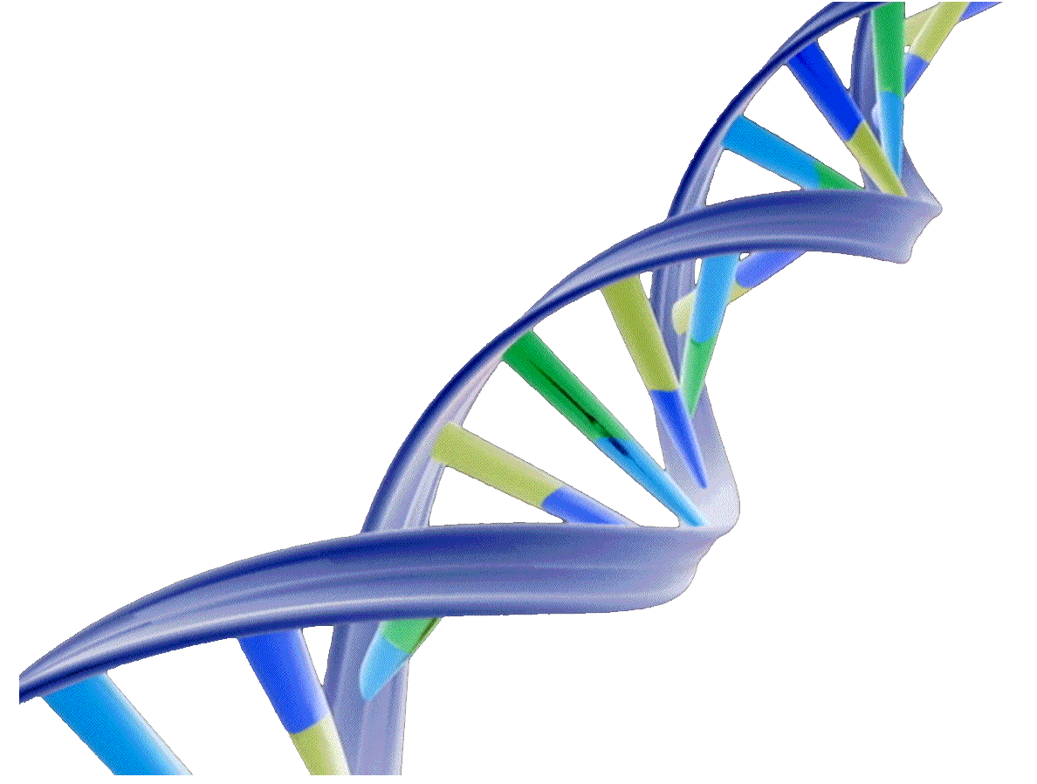
DNA
By C. Kohn Agricultural Sciences Waterford, WI
Source: joltgum.com

Slide 2
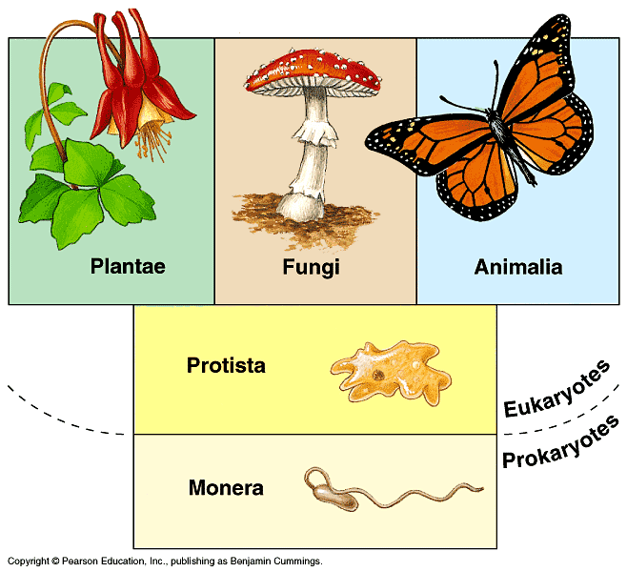
Endless Variety of Life
There are literally millions of different kinds of plants, animals, fungi, bacteria, and more.
While all of these species seem completely different, the proteins responsible for the unique traits of an organism are all created in the same way.
Differences in the kinds of proteins found in the cells of a particular species are what make the its cells function differently from the cells of another kind of species.
The kinds of proteins found in the cells of any given species is entirely dependent on the nucleic acids found in the cells of that species.
What makes one species different from another is solely due to differences in their nucleic acids and from the different proteins that result from them.
Source: web.eccrsd.us

Slide 3
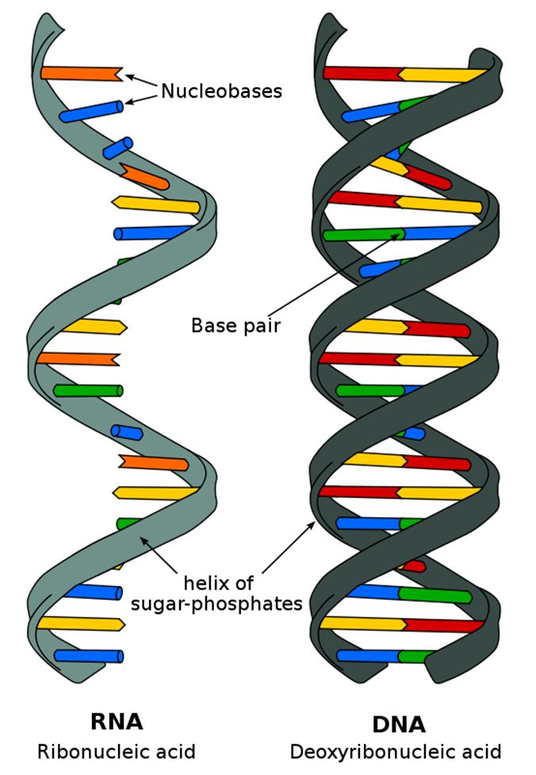
Nucleic Acids
Nucleic acids are macromolecules found in the cells of all living organisms.
There are two kinds of nucleic acids - DNA and RNA.
Almost all living species use double-stranded DNA to permanently store the information needed to assemble the proteins needed for each cell to function.
While very few species use single-stranded RNA to store information, almost all species use RNA to copy their DNA and assemble a protein from amino acids based on the information stored in their DNA.
Source: biobook.nerinxhs.org

Slide 4
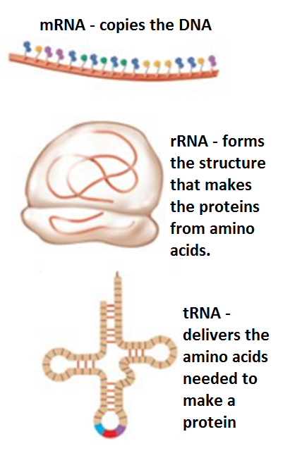
RNA and Codes for Proteins
Single-stranded RNA is mostly used by cells to:
a) copy the information stored in DNA
b) assemble the protein, and…
c) deliver the ingredients needed to make a protein.
Every protein in every cell corresponds to a specific sequence of DNA that instructs a cell how to assemble that protein.
A protein cannot be assembled by a cell unless there is a gene for that specific protein in its DNA.
The differences we see among different kinds of species is due to the fact that each species has its own unique combination of genes in its DNA.
These genes determine the unique combination of proteins found in that species that create its unique traits.
Source: www.studyblue.com

Slide 5
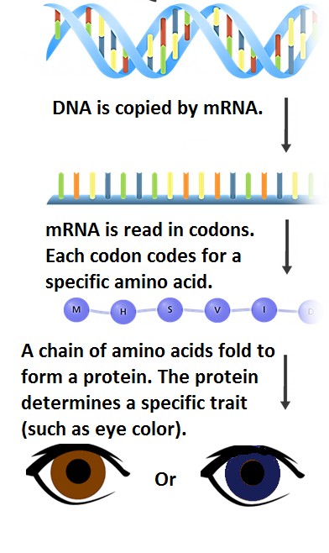
Proteins Determine Traits
The traits exhibited by a species depend on its DNA.
However, the visible traits of a species are actually directly created by the proteins of that species.
Proteins are large macromolecules made from different combinations of 22 different organic molecules called amino acids.
The information stored in DNA determines the order in which amino acids are assembled.
The order in which amino acids are assembled determines the protein that is created.
The protein that is created determines the trait that is exhibited by an individual.

Slide 6
DNA → RNA → Proteins → Traits

Slide 7
Genes → Proteins → Traits
For example, your eye color is determined by a specific kind of protein.
This protein for eye color was created using information from a specific section of your DNA.
The protein for blue eyes has a different structure than the protein for brown eyes.
Genes determine which proteins are made in a cell.
A gene is just a section of DNA that codes for a specific kind of protein.
In order to have a trait, an organism must have a gene that is used to create the protein responsible for that particular trait.

Slide 8
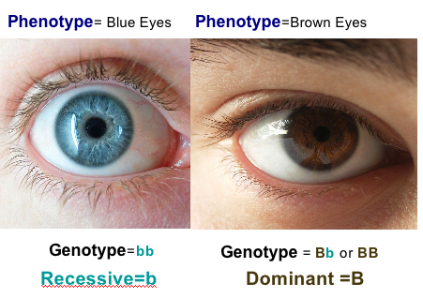
Genotypes and Phenotypes
The information that is stored in the genes in the DNA of an individual would be the genotype of that organism.
The observable traits (that result from the proteins assembled using the information from DNA) would be the phenotype of that organism.
In the case of your eye color, your genotype for eye color is the specific section of DNA (the gene) that is used to create the proteins that determine your eye color.
Your phenotype for eye color would be the color of your eyes that results from the proteins assembled in the cells of your eyes,
Source: www.cper.org

Slide 9
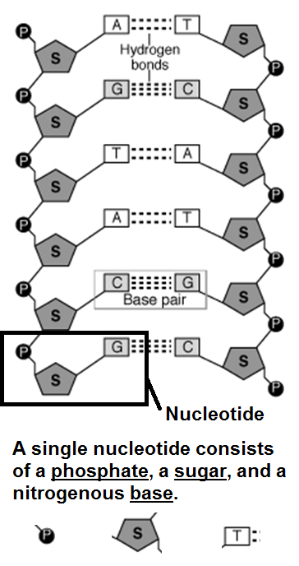
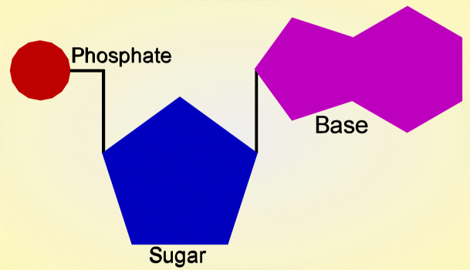
Polymers and Nucleotides
Source: study.com
DNA and RNA are polymers.
A polymer is a type of macromolecule made of a chain of molecules that repeat over and over.
The molecule that repeats over and over in DNA is a nucleotide. A nucleotide is the subunit (or building block) of DNA.
A nucleotide is a complex molecule that is made from 3 separate smaller molecules; these 3 molecules are:
1) a phosphate
2) a 5-carbon sugar
3) a nitrogenous base
Source: www.biologyjunction.com

Slide 10
Nitrogenous Bases
A nitrogenous base is a molecule that actually stores the information found in DNA.
The sugar and phosphate only exist to give structure to DNA; the combination of bases is what creates & stores the genetic information.
Just like you need paper and a metal spiral in a notebook to hold your written notes, your DNA needs the sugar and phosphate to hold the bases.
There are 4 kinds of nitrogenous bases in DNA.
They have actual names, but most of the time we only refer to them as letters: C, G, A, and T.
RNA also has 4 nitrogenous bases: C, G, A, and U.
Notice that three of the bases are exactly the same in RNA as in DNA.
The only difference is that a T in DNA is a U in RNA.
Source: https://myweb.rollins.edu/jsiry/DNA_Basepairs.gif

Slide 11
Notebooks vs. Nucleic Acids
The sugar and phosphate of DNA are like the spiral and paper of a notebook. They aren’t the information; they just hold the information.
The combination of bases of DNA are like the words written in a notebook – different combinations of letters enable actual information to be recorded in both cases.
DNA Image from www.bio1100.nicerweb.com

Slide 12
Great Combinations are Always Together
Because of both size and chemical bonding, A is always bonded to T and C is always bonded to G.
A and G are larger molecules than T and C.
If an A were bonded to a G, they would be too large to fit inside the width of DNA.
If C were bonded to T, it would be too small to reach the sides of the DNA molecule.
In addition to this, C and G have three bonding sites to attach to each other, while A and T only have two bonding sites.
Trying to pair an A with a C would be like trying to insert a three-pronged electrical plug into a two- pronged outlet.
Source: https://myweb.rollins.edu/jsiry/DNA_Basepairs.gif

Slide 13
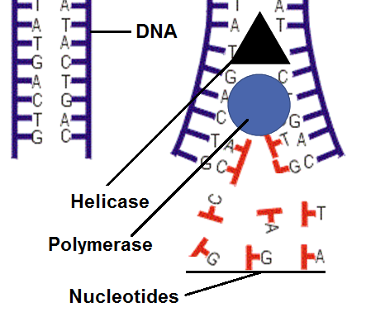
Making Copies
Source: biology.stackexchange.com
Because A is always bonded with T, and because a C is always with a G, this makes it easy for a cell to make a copy of DNA.
To replicate DNA, a cell simply pulls the double- stranded DNA apart to make two single stands.
A specific enzyme called polymerase then copies the DNA strand by adding the complementary base to the other side of each piece of single stranded DNA.
For example, if a section of single stranded DNA was A - G - C - T, the polymerase enzyme would add T - C - G - A to fill in the other side.
There are many free-floating nucleotide bases surrounding DNA and polymerase, and these are added by polymerase to DNA when making a copy.

Slide 14
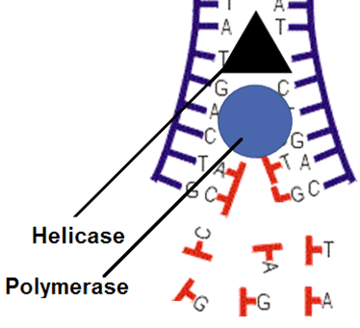
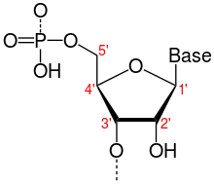
5 → 3 is Forward for DNA
Before polymerase can copy DNA, the strand of DNA has to be opened by a different kind of enzyme called helicase.
Helicase 'unzips' DNA so that polymerase can come in behind it and make the copy.
Because there is no top, bottom, left, or right inside of a cell, the polymerase enzyme needs a way to determine what direction to start copying DNA.
Polymerase will use the order of carbon atoms on the sugar molecule to know which way is 'forward'.
There are 5 carbon atoms on the sugar molecule in each nucleotide; polymerase always goes from the 5th carbon atom to the 3rd carbon atom when it is copying DNA (see the image of the nucleotide on the top right).
Source: biology.stackexchange.com
Source: upload.wikimedia.org

Slide 15
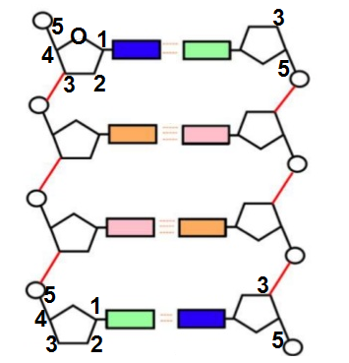
DNA is always read in a 5’ → 3’ direction.
5’ and 3’ refer to the numbering of the carbon atoms on the sugar molecule (clockwise from the oxygen atom on the sugar).
The direction DNA is read on one side will be opposite of the direction in which it is read on the other side (e.g. if the left side is from the top down, the right side will be read from the bottom up).

Slide 16
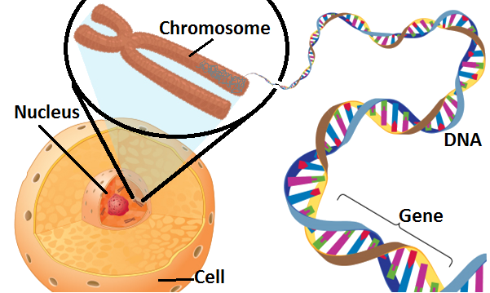
Protecting DNA
In order to protect the DNA from mutation, it is packaged into tight bundles called chromosomes.
A mutation is a change to the order of nitrogenous bases in a strand of DNA.
In eukaryotic organisms (those with organelles), these chromosomes are then stored in a special cellular organelle called the nucleus.
A nucleus is like a cell within a cell providing additional protection from mutation.
In order to go from stored information in the DNA to a functional protein, most cells depend on RNA.
RNA is needed to get from a) the information that is stored in DNA to b) having a functional, working protein made from the right combo of amino acids.
Source: kids.britannica.com

Slide 17
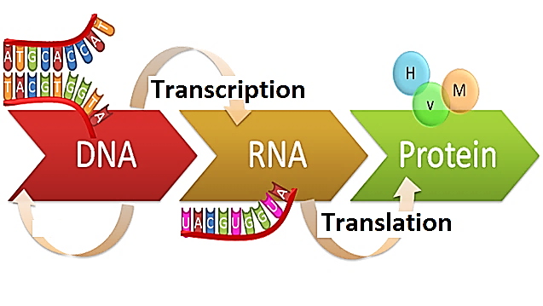
Transcription & Translation
The process of making a functional protein using the information stored in DNA begins with 2 steps: transcription and translation.
Transcription is the process in which a copy of DNA is made.
Translation is the process in which the copy of DNA is used to assemble amino acids in a specific order to create a protein.
Transcription and translation are sort of like making a recipe.
Transcription is like the process of getting a copy of the family recipe that you want (because you don’t want to damage the original cookbook, you use a scanner to make a copy).
Translation is like the process of actually using the recipe to acquire the needed ingredients and combine those ingredients to produce what you want to eat.
Source: genius.com

Slide 18
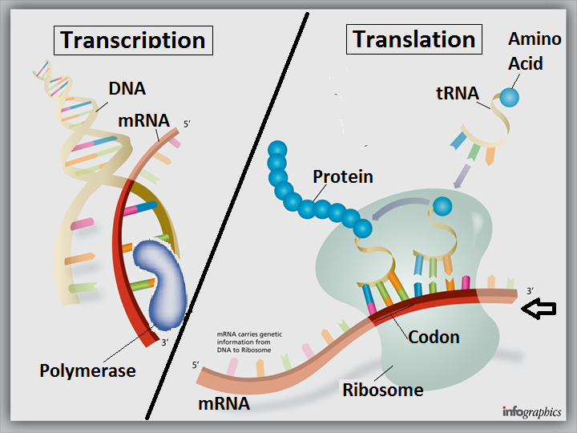
Transcription & Translation
In transcription, polymerase creates an mRNA copy of the DNA.
In translation, the mRNA copy is read by a ribosome, and tRNA delivers the amino acids needed to make a protein.
Source: http://www.ignyc.com/wp-content/uploads/2012/11/transcription-translation.png

Slide 19
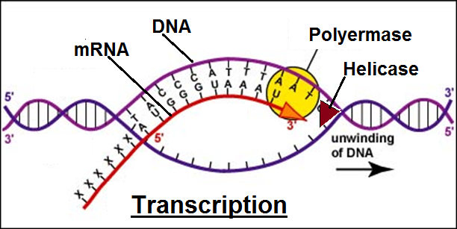
Steps of Transcription
The process of making a protein begins with transcription.
A transcript is just a copy of something.
Transcription is the process of making a copy of something.
In this case, transcription is the process of making of copy of DNA using mRNA.
Transcription begins when DNA is opened by the helicase enzyme.
A special kind of polymerase (called RNA Polymerase) then creates a copy of DNA.
The copy of DNA is made from single-stranded RNA.
This RNA copy of DNA is called mRNA (short for messenger RNA).
Source: www.tokresource.org

Slide 20
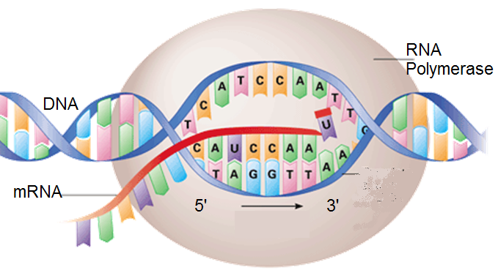
Converting from DNA to RNA
When RNA Polymerase makes a copy of DNA, it begins at the 5’ end of DNA and moves toward the 3’ end.
As it moves along the section of DNA, RNA Polymerase add the complementary base for every base that it encounters.
For example, if polymerase encounters a G, it will add a C to the mRNA.
If it encounters a C, it will add a G to mRNA.
If it encounters a T, it will add an A to mRNA.
If it encounters an A, it will add a U to mRNA (because there are not T’s in RNA, only U’s).
Source: www.mtchs.org

Slide 21
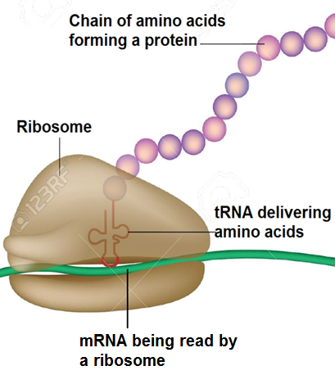
Steps of Translation
Translation begins when mRNA leaves the nucleus and goes into the cytosol (the ‘jelly-filling’ of the cell).
In the cytosol, the mRNA copy makes contact with a structure called a ribosome.
A ribosome is what actually makes a protein from amino acids.
A ribosome is a “protein factory” for the cell.
The ribosome is mostly made from unique kind of RNA called rRNA (short for ribosomal RNA).
Cells have LOTS of ribosomes!
While a bacterial cell may have 20,000 ribosomes, mammalian cell may have as many as10 million ribosomes.
Source: www.123rf.com

Slide 22
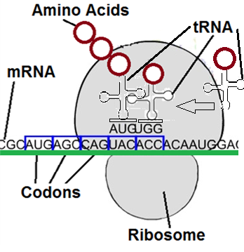
Ribosomes Read DNA in Codons
The ribosome reads mRNA one codon (group of 3 bases) at a time.
The mRNA moves through the ribosome like a train moves through a tunnel.
As each codon enters the ribosome, another kind of RNA binds with each codon on mRNA.
This kind of RNA, called tRNA (short for transfer RNA) delivers the amino acid that the codon codes for.
Source: https://bioweb.uwlax.edu/GenWeb/Molecular/Theory/Translation/ribosome3.jpg`

Slide 23
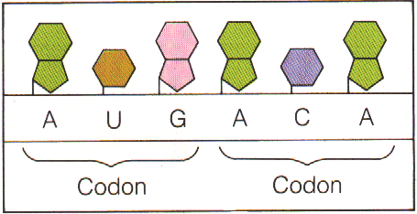
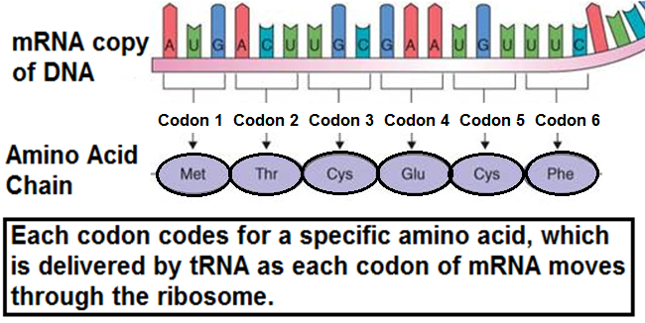
Codons code for Amino Acids
Source: www.perkepi.com
Each codon (or group of 3 bases) codes for a specific amino acid.
In order to assemble a protein, a ribosome simply needs to 'read' mRNA in groups of 3 bases.
Each group of three bases will tell that ribosome what amino acid should be added.
The order of the codons in a strand of mRNA directly corresponds to the order of amino acids in the needed protein. ➔
Source: www.rci.rutgers.edu

Slide 24
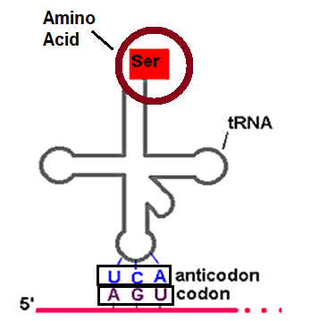
tRNA Delivers Amino Acids
There are many kinds of tRNA, one for each kind of different amino acid.
The specific codon in mRNA attracts the anticodon on a tRNA that is complementary to those 3 bases.
For example, if the mRNA codon in the ribosome is AGU, the tRNA with the anticodon UCA will deliver an amino acid.
When the anticodon of tRNA makes contact with the mRNA codon in the ribosome, the amino acid will detach from the tRNA.
This amino acid will bind to other amino acids that have already been delivered to the ribosome.
This will form a long chain of amino acids that will become the protein.
Source: bioserv.fiu.edu

Slide 25
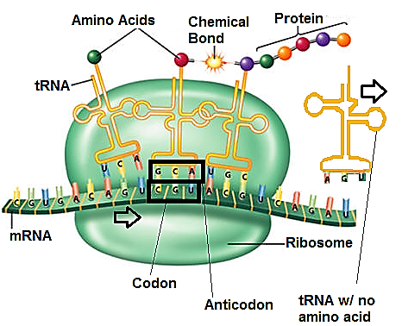
Amino Acids: Delivered One by One
The mRNA will enter the ribosome in a codon-by-codon fashion until the entire mRNA strand has moved through the ribosome.
For each codon that enters the ribosome, the appropriate amino acid will be delivered by tRNA.
Amino acids will be delivered one-by-one to the ribosome until the entire stand of mRNA has gone through that ribosome.
As each amino acid is delivered by tRNA, it will be added to a growing chain of amino acids that will eventually become the protein.
Source: mind42.com

Slide 26
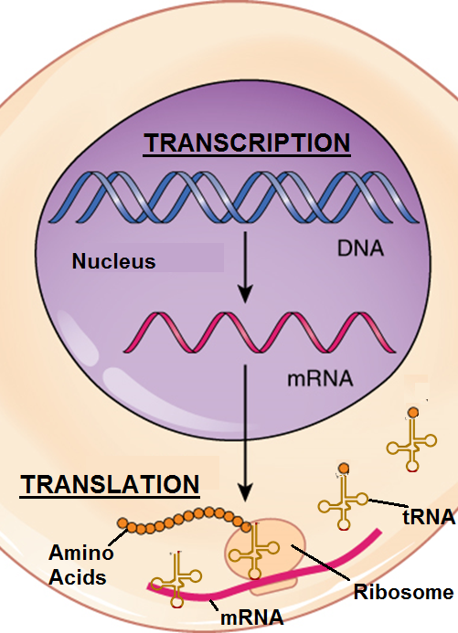
Summary
Transcription is when an mRNA copy of DNA is made in the nucleus by polymerase enzyme.
Translation is when the mRNA copy leaves the nucleus and goes into the cytosol, where it will move through a ribosome three bases (or one codon) at a time.
As each codon moves through the ribosome, tRNA delivers the appropriate amino acid. Amino acids are delivered one at a time to form the protein.
Once assembled, the protein will leave the ribosome to perform its specific function.
The mRNA will be broken down by the cell.
The rRNA in the ribosomes and the tRNA in the cytosol will repeat their function to make a new copy strand of mRNA for a different protein and the processes of transcription and translation will repeat all over again.
Source: oerpub.github.io

