Slide 1
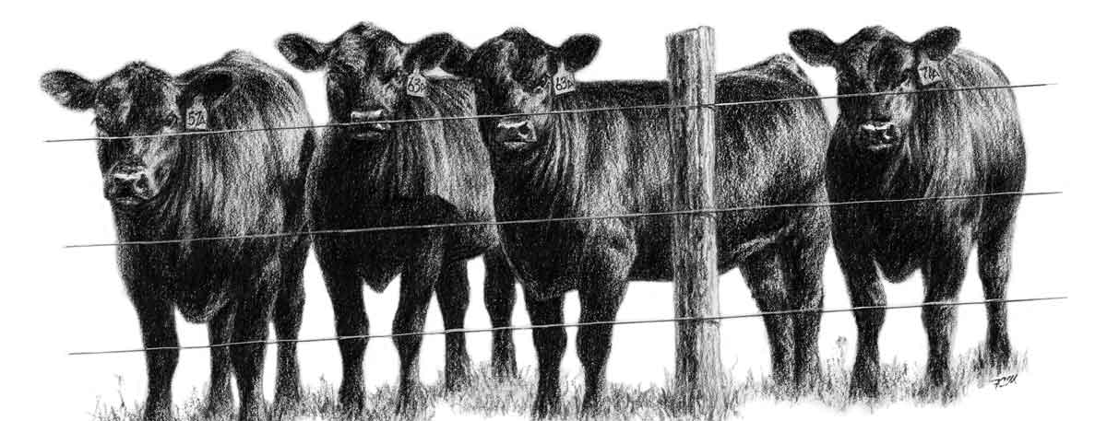
Nutrition & Ruminant Anatomy
By C. Kohn
Agricultural Sciences
Waterford, WI
Image Source: galleryhip.com

Slide 2
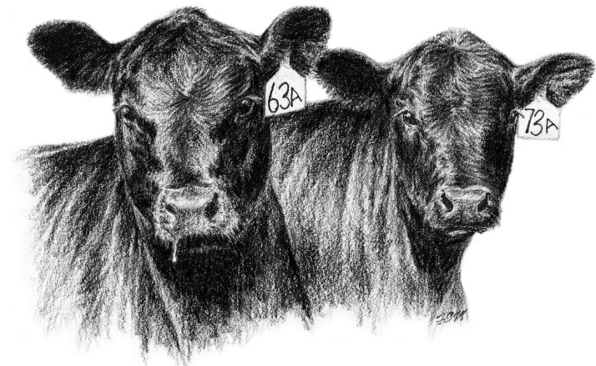
Nutrition
Nutrient requirements vary widely from species to species and even from individual to individual in many cases.
The type of species, the environment in which the species is found, the production requirements expected of that species, and even the prior diet of an individual can all affect the nutrient requirements of that species.
The science of nutrition entails the study of how living organisms acquire and utilize the nutrients that their bodies need in order to properly function.
An animal nutritionist is a professional who studies the effect of diet on the health, wellbeing and productivity of animals.
All living organisms need strategies to acquire and/or produce each of the following kinds of nutrients: water, carbohydrates, fats, proteins, vitamins, and minerals.
Each of these six kinds of nutrients plays a different specific role in a living organism.
The role played by each nutrient is roughly the same no matter what the kind of organism.
For example, sugars (a carbohydrate) are the primary source of dietary energy regardless of if an organism is a plant, animal, or bacteria.
Source: www.littlebellemont.com

Slide 3
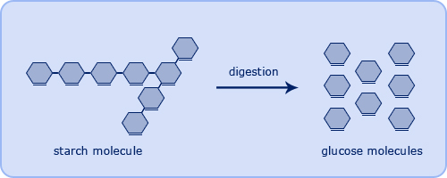
Water & Carbohydrates
Water is necessary for regulation of body temperature, growth, reproduction, lactation, digestion, lubrication of joints, eyesight, and as a cleansing agent.
Limiting water intake can depress animal performance more quickly and drastically than any other nutrient deficiency.
Low quality water will result in reduced water and feed consumption.
Waterers for animals should be elevated to ensure cleanliness and to prevent contamination and the spread of disease.
Carbohydrates are the primary source of energy for an animal.
Carbohydrates are composed of sugars, starches, and fiber (cellulose).
Carbohydrates are broken down into individual glucose molecules by digestive enzymes.
Carbohydrates are most prevalent in grains and vegetables, but can also be found in smaller amounts in other types of foods (for example, milk contains lactose (milk sugar), which is a carbohydrate).
If an animal’s diet is too low in carbohydrates, their body will begin to utilize proteins as an inefficient source of energy, reducing the availability of this nutrient for other purposes.
Source: www.passmyexams.co.uk

Slide 4
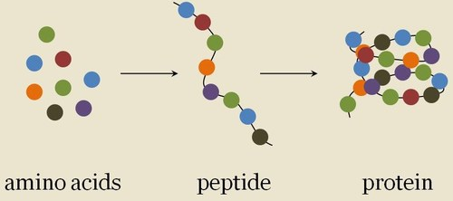
Fats & Proteins
Fats can also serve as a source of energy in some animals.
The amount of fat in an animal’s diet depends primarily on the animal’s digestive tract and feeding behaviors.
Fat is more likely to comprise a larger percentage of the energy requirements of a carnivore like a dog or cat as opposed to herbivores like cattle and goats.
However, fats can be a valuable source of energy for cattle in addition to carbohydrates due to the increased energy required for production.
Common additives to the diets of cattle, including cotton seed and dried distillers grains, can provide an energy boost to aid cattle in energy-demanding situations such as pregnancy and lactation.
Dietary proteins are the ‘building blocks’ of tissue in animals.
Proteins are the functional molecules in an organism’s body.
Proteins do most of the work in cells and are required for the structure, function, and regulation of the body's tissues and organs.
Proteins are made up of chains of hundreds or thousands of molecules called amino acids, which serve as the ‘building blocks’ of proteins.
Source: www.worldaccordingtomaggie.com

Slide 5
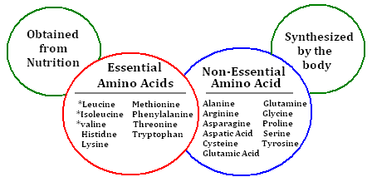
Amino Acids
There are 27 amino acids that exist; however, most species do not utilize all of these amino acids in their diet.
Cattle utilize 20 amino acids to produce their proteins while dogs consume 23 amino acids. The amino acids consumed by any animal can be categorized as essential amino acids or nonessential amino acids.
Essential amino acids are those that cannot be made by that animal and must be consumed by the animal in order to form the proteins that it needs to survive
In cattle, 10 amino acids are considered essential amino acids. While cattle can make some of these 10 amino acids, they cannot do so at a rate that meets their bodily needs, especially during high growth or high production.
Nonessential amino acids are those that can be synthesized by the animal if they are not consumed in the animal’s diet.
Source: chemistry.tutorvista.com

Slide 6
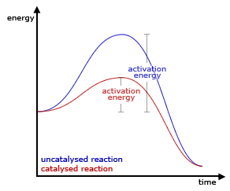
Proteins & Vitamins
Protein can serve as a source of energy if the dietary supply of fats and/or carbohydrates is too low or the supply of proteins is too high.
However, proteins are a far less efficient source of energy than carbohydrates or fats.
The use of proteins for energy is one form of catabolism (the breakdown of proteins during digestion).
This is different from protein anabolism, which is the process in which proteins are assembled from amino acids into their functional versions.
Vitamins are a class of unique organic molecules that are required in small amounts in an animal’s diet and serve as catalysts for bodily reactions such as regulating bodily functions, supporting the immune system, acquiring other nutrients from the diet, and more.
A catalyst is a substance that increases the rate of a chemical reaction without undergoing any permanent chemical change.
Unlike proteins, carbohydrates, and fats, vitamins do not have a common structure or molecular characteristic; instead vitamins are usually grouped by their function.
Vitamins can be categorized as either fat soluble or water soluble.
Source; ch302.cm.utexas.edu

Slide 7
Fat Soluble Vitamins
Fat soluble vitamins are stored in the fat and are released as needed.
Fat soluble vitamins include A, D, E, and K.
Vitamin A is necessary for proper bone formation, bodily growth, eyes and vision, skin and hoof tissue repair, and energy metabolism.
Vitamin D is needed for bone growth and maintenance because it aids with calcium absorption (which is why milk is usually fortified with Vitamin D). Additionally, Vitamin D is needed to metabolize carbohydrates for energy, and it aids the immune system.
Vitamin E serves as an antioxidant, aids in the formation of biological membranes, and is important for muscle growth and structure.
Vitamin K is known as the ‘clotting vitamin’ because of the role it plays in the formation of blood clots after an injury. It may also be involved in increasing the strength of bones.
Source: thehealthygurus.com

Slide 8
Water Soluble Vitamins
Water soluble vitamins must be consumed daily by animals as they cannot be stored in the body.
Water-soluble vitamins include Vitamin C and the B vitamins.
Most animals synthesize their own Vitamin C; because of this, it is usually not needed in animal diets (humans are unique in the sense that they need to consume Vitamin C as part of their diet).
Most ruminants can also synthesize their own B-vitamins using the microbes in their rumen. B-vitamins include thiamin, niacin, choline, and B12 (cobalamin).
Thiamin (B1) and Niacin (B3) play key roles in the metabolism of carbohydrates into energy.
Choline is necessary for proper liver function in order to clear the body of toxins.
B12 is important for brain and nervous function.
Source; galleryhip.com

Slide 9
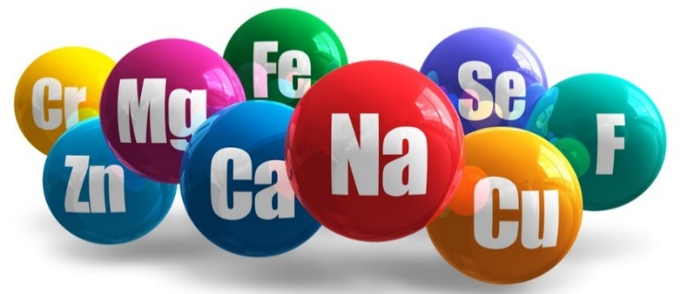
MacroMinerals
Minerals are inorganic elements required in small amounts in the diets of animals and can be categorized as either macrominerals or microminerals.
Macrominerals are needed in relatively large amounts in the diet (tenths of a gram to grams per day).
Macrominerals include calcium, chlorine, magnesium, phosphorus, potassium, sodium, and sulfur.
Calcium and phosphorus are primarily needed for bone growth and repair and are the most abundant minerals in an animal’s body. Calcium is also needed for muscle contraction; hypocalcemia (low calcium levels) can cause muscle weakness.
Potassium is the third most abundant mineral in an animal’s body and is needed for muscular development, glucose uptake, maintenance of water balance, and regulation of the heartbeat and communication between the brain and muscles.
Magnesium is needed for muscular health and skeletal growth.
Sodium and chlorine together form salt (sodium chloride, NaCl), which along with potassium is critical for maintaining water balance. Sodium, along with potassium, is also critical for creating the electrical signals in neurons.
Sulfur is necessary for protein synthesis.
Source; www.thevitaminmag.com

Slide 10
Microminerals
Microminerals are also known as trace minerals and are needed by the body in very small amounts.
Even though microminerals are as important as macrominerals in regards to the roles they play in the body, they are needed in far smaller amounts (a millionth of a gram to a thousandth of a gram per day).
Microminerals include chromium, cobalt, copper, fluorine, iodine, iron, manganese, molybdenum, selenium, and zinc.
One of the most important of these microminerals is iron, which is required for the production of hemoglobin, the protein in red blood cells that carries oxygen in the blood.
A lack of iron can lead to anemia, a decrease in red blood cells and/or hemoglobin, resulting in decreased oxygen transport that causes fatigue and weakness.
Copper is necessary for the absorption of iron from the diet. A copper deficiency can also lead to anemia.
Zinc is necessary for healthy bones, skin, hair, and feathers.
Fluorine is necessary for bone density and for strong teeth (which is why many dental products contain fluoride).
Manganese is necessary for the formation of normal bone and connective tissue; a deficiency can lead to slipped tendons (a common disorder in poultry called perosis).

Slide 11
Classes of Digestive Tracts
Animals have developed complex strategies for acquiring and metabolizing the needed amounts of water, carbohydrates & fats, proteins, vitamins, and minerals needed for a healthy, functioning body.
While different animals have different feeding strategies, all animals need to acquire the same kinds of nutrients as any other living species.
The varieties of evolutionary digestive strategies are the result of different selection pressures over time; no one digestive strategy is perfect and all have different benefits and drawbacks.
Four primary groups of digestive tracts exist among animals to process the energy captured in plants (or in other animals that eat those plants):
Monogastrics (humans, pigs, dogs): one simple stomach that secretes acid
Avian (birds): consists of a crop (where food is stored and soaked), a proventriculus stomach (similar to monogastrics) and a gizzard, in which grit or stones act like our teeth do to pummel food into smaller sizes.
Ruminant (cattle, deer): a multi-chambered stomach that ferments dense cellulosic carbohydrates into a more digestible substance before absorption.
Post-gastric fermenters/pseudo-ruminants (horse, rabbits): a simple stomach is followed by a cecum (a pouch connected to the large intestine) filled with bacteria that ferment and break down any plant material not digested in the stomach.

Slide 12
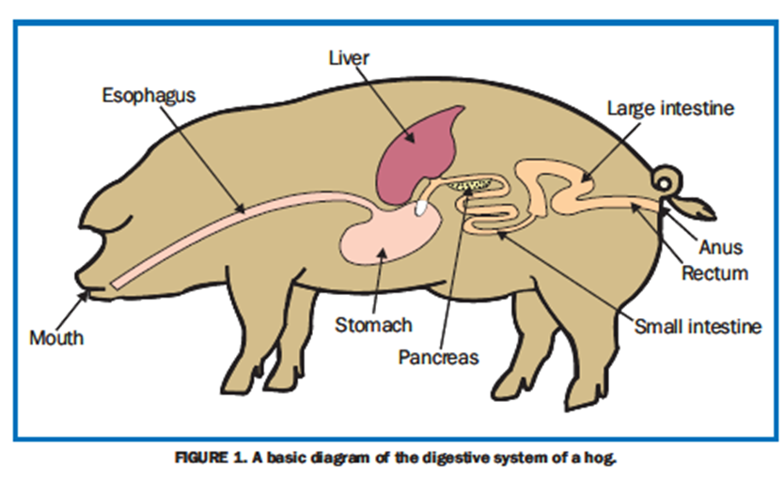
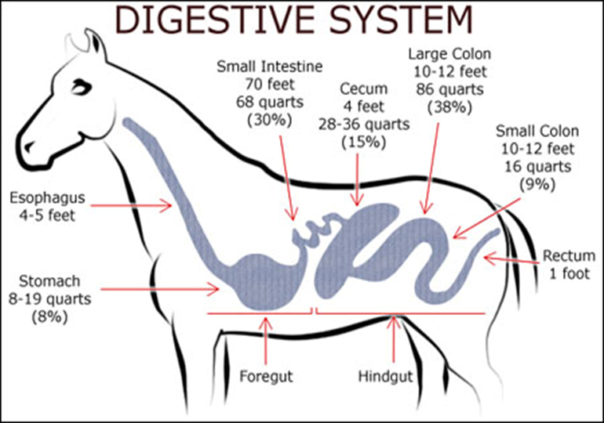
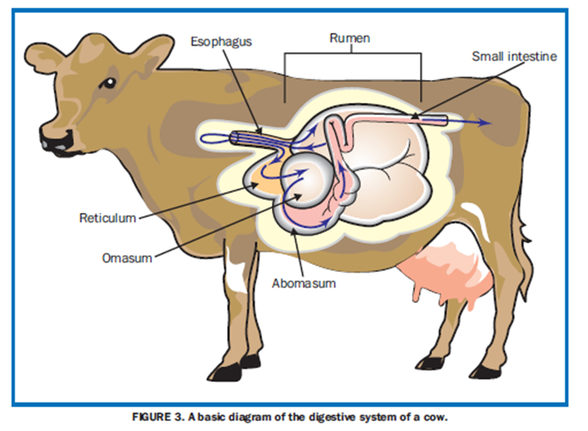
Monogastric
Avian
Post-gastric Fermenters
Ruminants

Slide 13
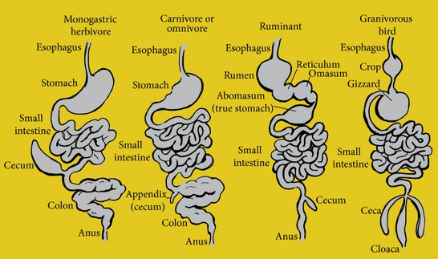
Digestions in Ruminants
Digestion in ruminants is similar to monogastrics (like humans and dogs) in many ways.
The primary difference between ruminants and monogastrics is that ruminants have stomach chambers before their ‘true stomach’ that contain microorganisms (see diagram below).
These microbes can ferment fibrous carbohydrates into simpler, easier-to-digest substances that can then be digested in a manner similar to how humans digest their own food.
Many of the other structures in a ruminant’s digestive tract are similar to that of a monogastric species and perform similar roles.
For example, the small intestine absorbs nutrients in a similar manner in both ruminant and monogastric species.
Source: www.hindawi.com

Slide 14
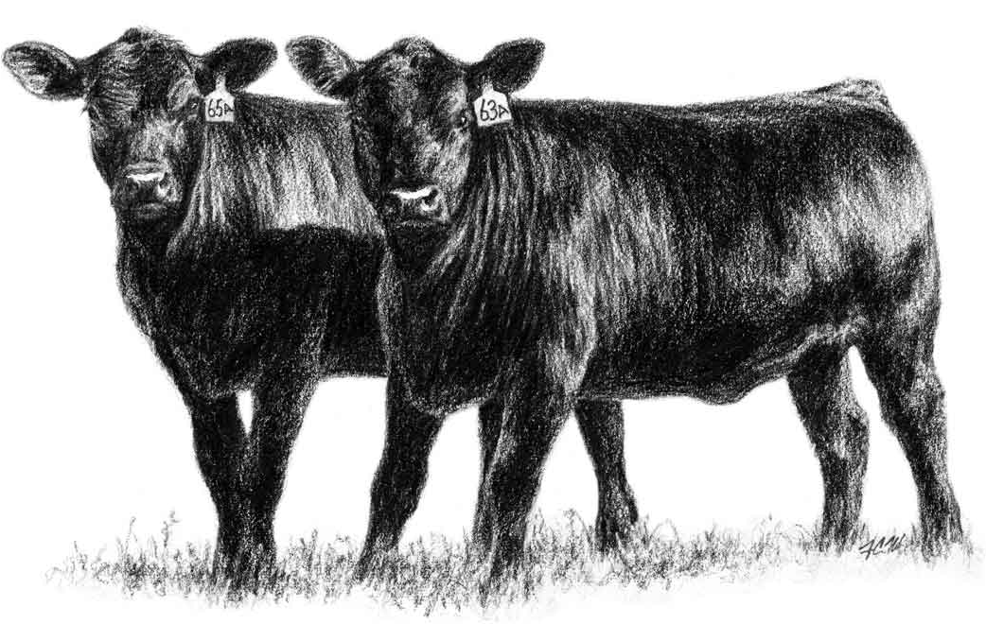
Advantages of Ruminants
Ruminants have many advantages over other kinds of species.
The biggest advantage of ruminants is that they can consume cellulosic forages such as hay and alfalfa. These sources of nutrition make up a large quantity of the world’s available feed resources and have ruminants to exist throughout many different environments.
Ruminants also have a unique ability to acquire protein from the microbes in their digestive tract in order to acquire their needed amino acids. This enables ruminants to acquire the large amounts of protein that they need from a diet that is actually usually low in protein.
Ruminants are also able to acquire vitamins from their microbes, including B-vitamins and Vitamin K.
Source: www.angus.org

Slide 15
DisAdvantages of Ruminants
Ruminants also have many disadvantages, including…
Digestive problems – ruminants are more prone to digestive disorders than other kinds of organisms, including bloat (excess gas production), acidosis (acidic digestive tract), twisted stomach (displaced abomasum), and more.
Heat production – the fermentation of feed in the digestive tract produces excess heat; most cattle are comfortable in environments that are cool or cold, and hot environments can cause reductions in feed intake and production.
Gas production – carbon dioxide and methane result as sugars and starches are fermented. As a result, the energy of sugars and starches can be lost due to excess gas production.
This also has an environmental concern associated with it, as CO₂ and methane are potent greenhouse gases. The UN’s Food and Agriculture Organization estimates that animal production causes about18% of global greenhouse gas emissions.
However, improved genetics and management techniques could reduce this by at least 30%; for example, the greenhouse gas emissions per gallon of milk produced have been reduced by 63% since 1944, and American cattle have far lower GHG emissions compared to most other countries.

Slide 16
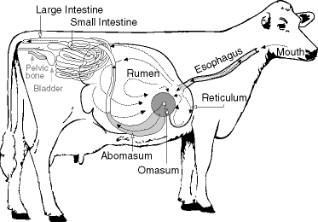
Through the Ruminant Tract
It will take 1-3 days for food to completely pass through the digestive tract of a cow.
This process begins in the mouth with chewing in order to reduce the particle size of the forage (cellulosic feed such as hay or alfalfa).
This enables digestive enzymes to have easier access to the food.
Digestive enzymes in saliva are mixed with food before it passes down the esophagus, the tube that leads to the stomach chambers.
A cow will need to produce 100-150 liters of saliva per day to provide the fluid needed for fermentation and to regulate the pH (acid- base balance) of the stomach chambers to ensure the survival of the microbes that ferment the food.
Source: www.reddit.com

Slide 17
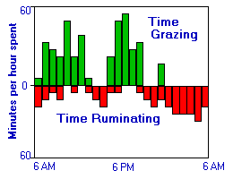
Chewing Cud
When a cow ‘chews its cud’, some of the larger food particles will be regurgitated, chewed again, and re-swallowed.
This is important because cattle do not thoroughly chew their food when they first consume it in order to maximize the amount of food they are able to consume in a short amount of time.
A cow is able to regurgitate its cud due to a special contraction of the reticulum (second stomach chamber).
This contraction is followed by reverse peristalsis (contraction and relaxation of the muscles of the esophagus in order to move a food bolus).
The period of time in which a cow chews its cud and digests its food is called rumination.
Rumination mostly occurs when the cow is not eating.
Cows must also belch while ruminating in order to release the enormous quantities of gas that build up as a result of fermentation in a process called eructation.
Anything that interferes with eructation is life- threatening to the ruminant because the expanding rumen rapidly interferes with breathing.
Source: http://www.vivo.colostate.edu/hbooks/pathphys/digestion/herbivores/rumination.html

Slide 18
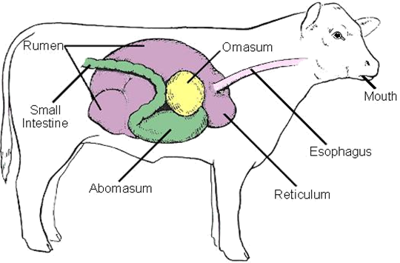
Stomach Chambers
The ruminant stomach is divided into four compartments: the rumen, reticulum, omasum and abomasum.
The rumen is a kind of like a living microbial fermentation vat.
Inside microbes live in an ideal environment where oxygen, pH, temperature, and food are all closely regulated.
Fermented feed is either absorbed by the rumen itself or is moved further along the digestive tract for more digestion and absorption downstream.
Source: research.vet.upenn.edu

Slide 19
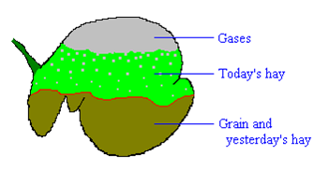
In the Rumen
The forage will remain in the rumen for about a day.
This is the amount of time needed to fully ferment the cellulose.
As plant matter is broken down, it will sink to the bottom where it can move on to the next chamber of the cow’s stomach.
Ruminal contractions, in which the rumen contracts and squeezes substances at the bottom to the top of the rumen, ensure complete and even fermentation of the forage.
If a ruminant is injured or sick, or if the rumen becomes too acidic, contractions can slow or cease, slowing or stopping digestion.
Source: research.vet.upenn.edu

Slide 20
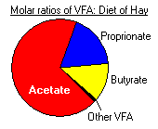
Fermentation
Almost all feed ingested by the cow is actually used to feed the microbes in its rumen.
The cow itself gets the waste byproducts from the microbes after they ferment the forage.
Fermentation occurs under anaerobic (w/o oxygen) conditions.
Because of this, the plant matter is fermented into Volatile Fatty Acids, or VFAs (instead of being completely respired into CO₂ and H₂O).
VFA’s provide the majority of the energy needs of an herbivore.
Source: research.vet.upenn.edu

Slide 21
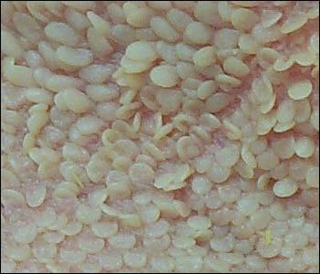
VFA’s
The main product of rumen fermentation of forage are volatile fatty acids, or VFAs.
VFAs are continuously absorbed by the walls of the rumen and provide the primary source of energy to the cow (~70% of the cow’s energy needs).
Absorption of VFA’s is also vital because failure to absorb VFAs would lower the pH of the rumen and kill the microbe populations, stopping forage fermentation.
To absorb VFAs, the walls of the rumen are lined with papillae, small projections of skin that increase surface area to increase absorption (see image).
Source: research.vet.upenn.edu

Slide 22
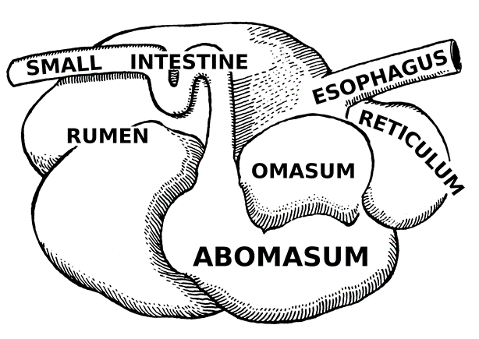
Rumen Microbes
The microbes of the rumen are absolutely vital to the health and survival of the cow. Rumen microbes provide 4 key services to a cow:
1. Amino acid production: rumen microbes provide the essential amino acids that a cow’s body cannot make.
2. Protein production: some proteins cannot be made from plant sources. Microbes can utilize sources of proteins that cows cannot (such as the urea created from protein digestion) to produce more protein for the cow’s body.
3. Synthesis of B-vitamins: without microbes, cattle would be deficient in all but two of the B vitamins.
4. Break-down of cellulose – rumen microbes produce the cellulase enzyme needed to break down cellulose into digestible glucose.
Source; en.wikipedia.org

Slide 23
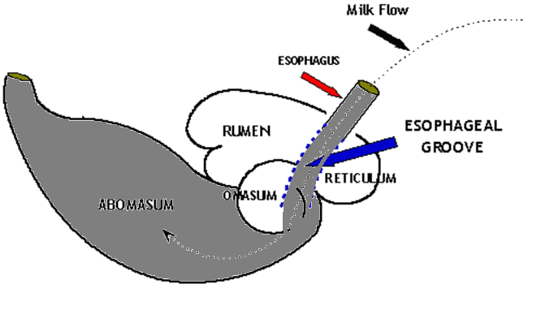
Rumen Development
In young cattle (0-3 months old), the rumen is not yet developed.
The esophagus and reticulum form a muscular tube called the esophageal groove that bypasses the rumen and goes directly to the abomasum.
This prevents the mother’s milk from being fermented or soured by the ruminal microorganisms when consumed by the calf.
The calf must acquire microbes for its rumen in this three-month period.
It is believed that these microbes come from the environment and from licking by the mother of the calf.
As the calf matures, the rumen and omasum will become larger and more muscular.
Rumen papillae will lengthen and decrease in number as part of rumen development.
Until the rumen and omasum completely develop, young calves depend on milk and easy-to-digest grains to meet their energy needs.
Source: calfcare.ca

Slide 24
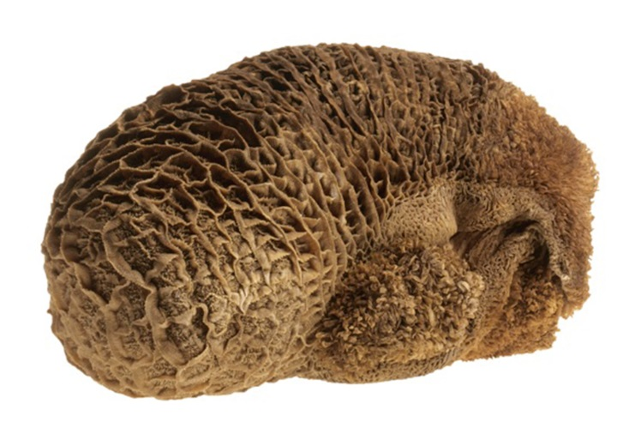
Reticulum & Omasum
The reticulum is a tough, lower portion of the rumen and is considered the second chamber of a cow’s stomach (top image).
The reticulum ‘catches’ foreign objects and prevents them from causing further harm downstream of the rumen.
It has a tough, honey-comb structure that is puncture-resistant.
After day-old forage is fermented in the rumen, it moves on to the third chamber, the omasum.
The omasum resembles pages of an open book.
The rumen will inject a soupy mixture of partially digested forage and microbes into this structure.
The main job of the omasum is the absorption of water, volatile fatty acids, and other nutrients.
The folds trap digested particles to maximize absorption.
Source: mandydenelzen.com
Source: www.abpoffal.com

Slide 25
Abomasum and Small Intestine
The abomasum of a cow is the fourth chamber and the “true” stomach and operates much like human stomachs by secreting acid and digestive enzymes.
What makes a cow’s abomasum unique is that it must handle far more bacteria than human stomachs because of the soupy forage/microbe mixture that is passed on from the rumen.
To handle this large quantity of bacteria, the abomasum secretes lysozyme, an enzyme that breaks down bacterial cell walls.
After the abomasum, plant matter will enter the small intestine.
Enzymes from the pancreas and intestinal walls, and bile from the liver will be used to further digest the plant matter.
Protein, starch, sugars, and fats will be further digested and sent into the bloodstream to be used by cells.
The small intestine contains numerous "finger-like" projections called villi (similar to the papillae in the rumen) that increase intestinal surface area to aid in nutrient absorption.
Muscular contractions of the intestine mix the digested food and move it along the tract.
Source; en.wikipedia.org

Slide 26
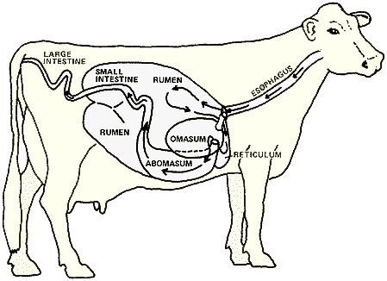
Large Intestine
Any plant matter that remains after the small intestine will be passed on to the large intestine.
This is the second site of fermentation (after the rumen) with a small amount of VFA production.
In post-gastric fermenters like horses, this is where most of the fermentation occurs.
The large intestine is also where excess water is reabsorbed.
Water must be reabsorbed after digestion in order to keep the body of the ruminant hydrated.
Inflammation of the walls of the large intestine can quickly lead to dehydration and possible death.
Any plant matter that remains at this point is excreted as manure.
Source: sci.waikato.ac.nz

Slide 27
Works Cited
Nutrient Requirements of Dairy Cattle:: Seventh Revised Edition, 2001
http://dairy.ifas.ufl.edu/rns/2012/1SchwabRNS2012.pdf
http://www.extension.org/pages/11231/current-status-of-amino-acid-requirement-models-for-lactating-dairy-cows#.VQbVglV4pBY
http://www.vetmed.vt.edu/vth/sa/clin/cp_handouts/Nutrition_Adult_Dog.pdf
http://msucares.com/pubs/publications/p2504.pdf
http://animalscience-old.tamu.edu/beef-skillathon/nutrition_digestivesystem.html
http://pods.dasnr.okstate.edu/docushare/dsweb/Get/Document-2032/E-861web.pdf
http://www.allaboutfeed.net/Nutrition/Feed-Additives/2012/10/Choline--An-Essential-Nutrient-for-Transition-Dairy-Cows-1096114W/
https://www.ipni.net/ppiweb/bcrops.nsf/$webindex/E43DC23D55DD68BF852568F00067C088/$file/98-3p32.pdf
http://www.ucv.ve/fileadmin/user_upload/facultad_agronomia/Producion_Animal/Vitamins_in_Animal_and_Human_Nutrition.pdf
http://www.chicagoagr.org/ourpages/auto/2011/3/14/56334481/The%20importance%20of%20proteins_%20minerals%20and%20vitamins.pdf
http://www.ansc.purdue.edu/courses/ansc221v/minerals.htm
http://dairycares.com/issue/climate-change
http://news.psu.edu/story/306497/2014/03/04/earth-and-environment/penn-state-led-project-aimed-reducing-greenhouse-gases
http://www.vivo.colostate.edu/hbooks/pathphys/digestion/herbivores/rumination.html

