Slide 1
ACT Science Prep
By C. Kohn
Waterford Union High School

Slide 2
Intro
The ACT Science exam is a test of your ability to think critically, form arguments based on evidence, and draw conclusions through data analysis.
The ACT Science exam consists of 40 questions that make up 25% of your final score.
  This test is the last you’ll take in part because it consists of elements from the three other areas of the ACT Exam.
You have 35 minutes to complete the exam, meaning you need to answer 1-2
questions per minute to finish on time.
  It covers four subjects: biology, chemistry,
  physics, and earth sciences.

Slide 3
How to succeed.
However, this test will not consist of facts or details about these subjects.
  In fact, you could know very little about these fields and still do well as long as you understand the underlying principles and elements of the scientific method and of scientific reasoning.
Studying a science textbook will not help you to prepare for this test.
  Knowing how science works and how scientists think will be the most crucial skills you will need.
  In addition to understanding experimentation and critical thinking, you will need to understand
  and utilize math, reading comprehension,
  and be able to compare and understand
  data and written arguments.

Slide 4
Data Analysis
The ACT Science exam questions consist of two kinds of passages: data analysis and compare/contrast.
  Data analysis is where you are provided with data from an experiment and will be asked to draw conclusions from this data.
Data analysis passages can occur in two ways: experiment passages and non-experiment passages.
  Experiment passages summarize research that was conducted and will present the
  data in tables or graphs.
  Non-experiment passages will focus
  more on the data about a phenomena
  and less on a specific experiment.

Slide 5

Compare and Contrast
Compare and contrast passages will ask you to consider the opposing views of two scientists and draw conclusions based on the evidence that supports each viewpoint.
  Usually there is no right or wrong view; instead some data will support one kind of view and other data will support the opposing view (much like how science often works; e.g. light sometimes behaves like a particle and sometimes like a wave).
  These are usually the most difficult
  passages and will require you to
  focus heavily on where the scientists’
  views are similar and where they are
  different.

Slide 6
Pacing
Optimal pacing is critical in order to do well on the ACT Science exam.
  You may not be able to answer all 40 questions in 35 minutes.
  This means that you may have to prioritize and focus on the types of questions in which you have the highest likelihood of answering correctly.

Slide 7
Rules of Pacing
There are two major rules for pacing:
  1. Answer as many questions as you can; even wrong answers get you more points than unanswered questions.
    Determine the score you think you want to achieve based on practice tests.
    Determine the number of questions you need to answer in order to achieve that goal
  2. Answer the easiest questions first.
    If you have no idea, guess and come back.
    Because each passages’ questions are specific to the information in that passage, try to finish the questions in each passage before moving onto a new one (even if you have to guess).

Slide 8
Practicing
It is important for you to take the practice tests as much as you can; this will enable you to determine your average score.
  Once you know your average score, set a goal to improve this score by 5-10 percentile points at most.
  Any goal higher than 5-10 percentage points is not feasible in most cases.
For example, if you got 28 questions correct out of 40, this would put you in the 80th percentile.
  You could feasibly improve your score with practice to the 85th or 90th percentile.
  This would require you to get 34 questions correct out of 40.
To get to the 99th percentile, you would need to score at least 37 out of 40.
  This means that statistically you would need to answer all 40 questions (because even if you could get all 40 correct, you are likely to make mistakes due to the pressure of actually taking the test).

Slide 9

The “How” of Science and the ACT Exam

Slide 10
Analysis & Logic
The ACT Science exam tests two main kinds of skills: analysis and logic.
  Analysis is simply your ability to draw conclusions based on the numbers that are provided.
    If a table, graph, or chart is provided to you, how well are you able to determine what actually happened?
    This involves simple “which is greater” type questions (or something of a similar nature); these are usually the easiest questions and entail about 13% of the test.
  Logic involves your ability to draw conclusions based on evidence.
    This is no longer the simple “which is greater/lesser” type of question but rather requires inference, or the ability to draw conclusions in circumstances where the evidence may not directly address the question.
    Nearly half of the questions will involve logic assessment.

Slide 11

Science 101
The scientific method entails a few ‘ingredients’ that have a constant meaning regardless of the type of experiment.
  You need to understand the meaning of a dependent variable, independent variable, and a control.
In science, the dependent variable
is the thing you are measuring
(imagine that the ‘d’ of dependent
is a measuring cup on its side).
  The dependent variable is usually a
  number.
  In any experiment, you can measure
  multiple items or just one.

Slide 12

Dependent Variables
For example, if you wanted to determine if a brand of fertilizer improved the growth of radishes, your dependent variable might be height, weight, width, rate of change of height, or all of the above.
  Notice that the dependent variable was not ‘growth’.
  Growth cannot be measured but change in height, final weight, or other specific measurements can be measured.
  A dependent variable should always be able to be measured in a numerical fashion.

Slide 13
Independent Variables
The independent variable is the one thing that you think may be the cause of a phenomena.
  For example, if you were testing a brand of fertilizer to determine its impact on the growth of radishes, the independent variable would be the brand of fertilizer
  .
There can only be ONE independent variable per experiment.
  If you have multiple independent variables, you wouldn’t know what is responsible for the changes you measured!
  For example, if you tested both a
  fertilizer and a different kind of soil,
  you wouldn’t know which was
  responsible for any changes you
  might observe.
Independent
Variable
=
“ONE”

Slide 14


Control
Every experiment needs to have a control.
  The control is the untreated group.
  If we were to conduct our radish experiment, we would have to have a group of radishes that didn’t receive the fertilizer we were testing as our independent variable.
  This would enable us to determine if any change in growth was due to the fertilizer or because of another unknown factor.
Experimental
Control

Slide 15
Science and the ACT
When you first see a passage on the ACT Science exam (or any scientific experiment in life), always begin by asking the following:
  What was the purpose of this work? What were they trying to determine?
  What did they compare? What was changed (the independent variable)?
  What was measured (the dependent variable)?
  What trends occurred in their data? How was the experimental data different from the control data? How was it similar?
  What was the outcome?

Slide 16

Types of ACT Science Questions

Slide 17

Strategies for specific kinds of questions.
In the following sections, we’ll consider strategies that maximize your ability to answer each of the following:
  Look-up Questions
  Spotting Trends
  Drawing Inferences
  Scientific Method
  Compare And Contrast
opticalres.com

Slide 18
Look-up Questions

Slide 19
Look-up Questions
Look-up questions are the easiest – you simply have to find the answer somewhere in the passage.
  Typically the answer you need for these questions will be in a table or a graph.
  There are typically 5-6 of these questions on the ACT Science exam (usually about one per passage).
Look-up questions often refer to a table or figure by name (e.g. According to Table 1…).
  Always answer these questions as you have the highest likelihood of getting these questions correct compared to all other kinds of questions.

Slide 20
Look-up Strategies
While these are the easiest questions, it is important to remember two strategies:
  Make sure you are looking at the right table or figure! It is easy to glance at the wrong table when stressed or in a hurry.
  Make sure you are only looking at the table or part of table mentioned in the question. Sometimes test-takers ‘think too much’ about a question and choose the wrong answer based on information that is present but not part of the question.

Slide 21
Look-up Strategies
Sometimes a look-up question will refer to a graph with x- and y-axes.
  Remember that the x-axis is horizontal and the y-axis is vertical.
  Often the x-axis plots the independent variable (the thing changed in an experiment) and the y-axis plots the dependent variable (the thing measured).
y-axis
x-axis

Slide 22

Anticipate the Answer
One strategy for a look-up question is to anticipate the answer; in other words, try to come up with the answer before looking at the available options.
  If you can find the answer on your own and then find an answer that matches it, you’re less likely to make a mistake or choose an answer that looks right but is not correct.

Slide 23

Trend-Spotting Questions
Source: culturewav.es

Slide 24
Trend-spotting Questions
The second kind of question involves spotting trends.
  Typically there are 5-6 trend-spotting questions on the ACT Science exam, or roughly one per passage.
  These are the second-easiest kinds of questions to answer.
  Trend-spotting requires you to identify what is known (your reference values) and then using this known information to determine a missing value.
Trend-spotting involves three key skills: interpolation, extrapolation, and graphic representation.
  Understanding how these skills work enables you to better apply these skills when they are needed for a question.

Slide 25



Interpolation
Interpolation involves finding a missing value that occurs among known data.
  For example, if using 1 mg of fertilizer increased final average radish height by 2 mm, and using 3 mg of fertilizer increased the final average radish height by 6 mm, then we could interpolate that using 2 mg of fertilizer would increase the final average radish height by 4 mm.
  Interpolation is usually fairly straightforward and is something that most of us do on a regular basis.
?

Slide 26

Extrapolation
Extrapolation entails estimation of a value outside of known data.
  In our radish example, we could conclude that adding 4 mg of fertilizer might cause the radish average height to increase by 8 mm (although we can’t be positive – at some point the fertilizer will have less impact on height and may even lessen the final height).
  Not having any other data, we would conclude that the most logical prediction is that 4 mg of fertilizer would on average increase the final height by 8 mm.
?

Slide 27
Graphic Representation
Graphic representation entails determining the relationship between two variables.
  For example, the radishes and fertilizer exhibited a direct relationship; the more fertilizer that was added, the taller the radishes grew.
    On a graph, this would occur as a line that moves upward as you go from left to right from the origin (or 0).

Slide 28
Graphic Representation
An inverse relationship is one where as more of one thing occurs, less of another occurs.
  For example, the addition of rubbing alcohol to the soil of the radishes would have a negative impact on the final average height of the radishes.
  On a graph (with amount of alcohol on the x-axis and final average height of radishes on the y-axis), this would appear as a downward line from left to right.

Slide 29
Graphic Representation
A combination relationship is one where there is both a direct and an inverse relationship between two variables.
  For example, if we kept adding fertilizer to the soil of the radishes, eventually the fertilizer concentration would become toxic to the plant.
  At some point, the fertilizer will inhibit the growth of the radishes.
  On a graph, this would look like an arch, with plant height increasing to a peak height, after which any more fertilizer would decrease the final average height of the plants.

Slide 30

Combination Relationships
This graph could represent how the addition of fertilizer causes a greater final average height to a point but after a certain application rate loses its ability to cause a greater final average height and even causes a decrease as toxicity builds.

Slide 31
Graphic Representation
Random relationships would have no clear, discernible trend. The line for this trend on a graph would appear to be zigzagged.
  In these particular situations, the independent variable has no predictable impact on the dependent variable.

Slide 32
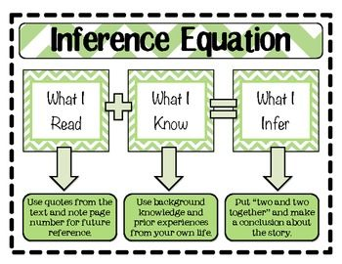
Inference Questions

Slide 33
Inference Questions
Science Inference questions are the ‘reading between the lines’ kind of questions.
  In these type of questions, you will be asked to come to conclusions based on the information in the overall passage.
  These are one of the most common
  kinds of questions found on the
  ACT Science exam (usually
  1 out of 5 questions are this
  type).

Slide 34
Inference Question Wording
Inference questions typically have wording similar to the following:
    The results suggest that the critical factor in determining when a plant flowers is most likely to be the...
    Which of the following statements is best supported by the first figure?
    Which of the following is the most likely interpretation of the data on vegetable spoilage?
    The researchers making the measurements for Table 3 might reach which of the following conclusions?

Slide 35
Inference Questions
Inference questions are moderately challenging; occasionally they might even rank among the hardest on the test.
  However, in all cases of inference questions, three of the four answers will not be supported by the passage.
  Three of the four answer options will either contradict the information provided in the passage or go too far and distort or misinterpret the information in the passage.
  This is a constant challenge to scientists – all scientists must extrapolate to determine
  the cause of a phenomenon but they
  must be careful not to ‘overreach’ and
  come to conclusions that are not
  supported by the data that exists.

Slide 36
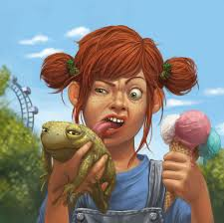
Inference vs. Misinterpretation
The ACT Science exam will regularly ask questions that may try to trick you into coming to conclusions that might make logical sense based on your life experience but that are not supported by the data found in the passage.
  For example, a passage might state that if someone has red hair, their parents had to have both carried the genes for
  red hair.
  However, it would be incorrect to
  say that both parents must have
  red hair.
Source: digital-art-gallery.com

Slide 37
Inference Questions
Inference questions require you to identify the main information of a passage; usually information will be provided that provides the basis of the main message of each passage.
  One way to simplify this process is to predict what would be the scientist’s hypothesis (e.g. how would the finish the phrase “I hypothesized that… because… “?).
The trickiest inference questions will introduce new information and ask you to come to a conclusion based on this information.
  These are usually best to save for last as they tend to be among the most difficult.

Slide 38
Inference, Compare & Contrast
Inference questions are very common in passages that contain summaries of two or more different experiments.
  Because of the large amount of information that is provided, and because this information sometimes contradicts other information provided, it is important to ask yourself the following before answering inference questions:
    What was the purpose of the experiment? What questions were they trying to answer?
    What are the variables in the experiments? What conditions change from one experiment to the next?
    What similarities and differences exist in the experimental results?
Science at its simplest is about finding differences between two situations.
  Focusing on what is similar and what is different between multiple experiments will help you the most with an inference question.

Slide 39

Scientific Method Questions

Slide 40
Scientific Method Questions
Questions about the scientific method require you to think like a scientist, and measure your ability to design and conduct a scientific experiment.
  These are among the toughest questions on the ACT Science exam.
  You must both have a clear understanding of the information in the passage as well as how science works.
If you do not have experience designing scientific experiments from scratch with no guidance from an instructor or a lab, these might be the toughest questions you face on the ACT (regardless of how many science courses you have taken in school).

Slide 41
These are the hard ones
Unless you have a strong background in designing scientific research methods, these questions are among the best to skip if you are falling behind.
  Fortunately, only about 5 out of 40 questions on the ACT Science exam are about the scientific method, and these five tend to be in groups of two or three among two passages.
  Even if you had to guess on these questions, the impact on your score is not as great as if you did poorly on other types of questions.

Slide 42
How to Spot Them
Scientific method questions tend to have a similar format, which makes them easier to spot.
  “How” is the key word for spotting a scientific method question. For example, a scientific method question may sound like one of the following:
    how scientists should go about testing a hypothesis
    how to construct an experiment
    how to interpret the results of an experiment
    how to investigate a phenomenon
    how to confirm a hypothesis
    how to modify a hypothesis in light of experimental results
Scientific method questions also tend to be very long.
  If you have multiple long questions that include “how”, you may want to consider moving on and coming back.

Slide 43
Scientific Method Questions
Scientific method questions will focus on five key aspects of science:
  Observations, Hypotheses, Predictions, Experimentation, and Modification.
Observation: most scientific inquiry begins with observation; for the purpose of the ACT Science exam, observation will entail your ability to identify to subject that is being studied within the context of the passage.
  For example, a question about observation might be as simple as identifying the key elements of the studied subject as described in the reading.

Slide 44
Hypotheses
Hypothesis: a hypothesis is essentially an educated guess about an unknown phenomenon.
  A hypothesis can be true or false; a scientist must collected data to confirm whether their hypothesis is supported or not.
  A common scientific method
  question is to have the test-
  taker form a plausible hypothesis
  after being provided with data
  or observations.
opticalres.com

Slide 45
Predictions
Prediction: like a hypothesis, a prediction is really an educated guess. In this case, the prediction will be more about the specific outcome of an experiment designed to test a hypothesis (if a hypothesis is the “what”, then the prediction is the “how much”).
  A hypothesis is a general educated guess about a phenomenon, but a prediction is how that educated guess would affect the outcome in a specific situation.
  For example, if you hypothesize that radishes lose more water in windier conditions, then you would predict that radishes in windy conditions will need water more often.
  On the ACT Science exam, you might be given the hypothesis of a scientist and then be asked to predict how an experiment would turn out if their hypothesis was correct.

Slide 46
Validity of Experiments
Experimentation: experiments in science exist to prove or disprove a hypothesis.
For an experiment to be valid, it must demonstrate four key qualities:
  Objectivity: objectivity is the elimination of bias, or favorability of one outcome over another.
  Scientists must take great care to ensure that the collection and/or interpretation of their data is not biased towards a specific outcome.
  One way of doing this is through a double-blind study, where neither the researchers nor the subjects know what treatment is being received until the data has been processed and interpreted.

Slide 47
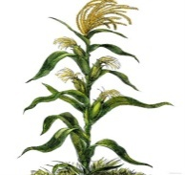



Validity of Experiments
  Reproducibility: this is simply the likelihood that if an experiment is reproduced, it will have the same outcome.
    Well-designed experiments should have the same results if performed under the same conditions regardless of who may being conducting the work.
Less reliable
More reliable

Slide 48
Validity of Experiments
  One independent variable: no matter what the kind of experiment, every experiment must have only one independent variable
    All other variables must remain constant among the control and research populations.
    Should there be more than one independent variable, it would be impossible to determine the cause of the changes in the dependent variables between the two populations.
You can only have one
independent variable!!!
NO EXCEPTIONS!

Slide 49
Validity of Experiments
  A control: all experiments must have an unchanged control population with which comparisons can be made.
    If all experimental subjects are treated with the independent variable, it would be impossible to determine the effect of that independent variable because there would be no untreated subjects from which a comparison could be made.
Scientific method questions about experimentation will often have to try to spot an error or develop a critique of an experiment pertaining to one of these four areas.

Slide 50
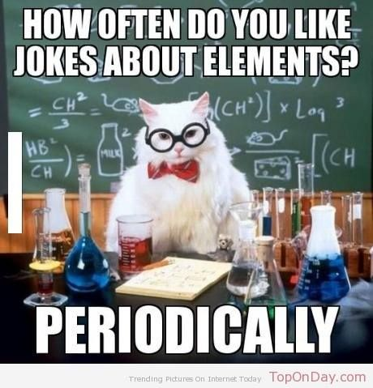
Modification
Modification: the final step of an experiment is to determine if the methods sufficiently tested the validity of a hypothesis.
  You might be asked to re-design an experiment so that it is a more valuable test of a hypothesis.
  Similarly, you might be
  asked to design a follow-up
  experiment in light of new
  information acquired from
  the first experiment.

Slide 51
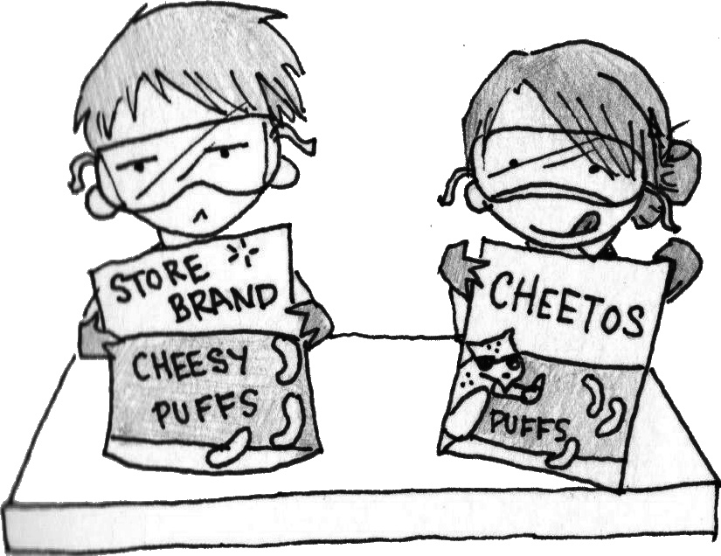
Compare & Contrast Questions
Source: http://arlingtonrobinson.weebly.com/uploads/3/9/3/2/3932951/1352559_orig.jpg

Slide 52
Compare & Contrast Questions
The final type of ACT Science question is the compare and contrast question.
  Compare and contrast questions present two sides to an issue.
  The two sides will be labeled (e.g. Scientist 1 thinks… Scientist 2 thinks… or Meteor Theory vs. Gradual Extinction Theory).
  While the data and graphs will be minimal in these passages, the amount of information to consider will be as great or greater as any other passage.

Slide 53
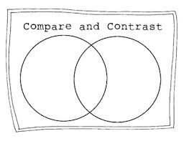
Compare & Contrast
To do well on these passages, you will need to understand…
  The key points of each theory.
  The similarities and differences between each theory.
  The evidence available to support each theory, and how that evidence may pertain to the other theory.
Source: www.teacherspayteachers.com

Slide 54
Compare & Contrast
Compare and contrast
questions will ask difficult
questions such as the following:
  What does Scientist A believe? What does Scientist B believe?
  On what points do both scientists agree?
  On what points do the scientists disagree?
  How would Scientist A respond to Scientist B?
  What evidence would strengthen/weaken the arguments of Scientist A/B?

Slide 55
Compare & Contrast
Like the scientific method questions, compare and contrast questions are often the hardest on the test.
  Often the passages will be written to make both sides seem equally plausible (a common occurrence in science). Do not read the passages assuming that one side is right and another is wrong.
Because of the amount of detail, information, and complexity in these passages, it is best to do these questions last.
  It is a good idea to simply use the process of elimination and your best guess on questions that are hard.

Slide 56
C&C Strategies
The following strategies are helpful for compare and contrast questions:
  Know what is being asked!
    Quickly write down the key arguments and pieces of evidence for each side.
    Often questions are designed to make you confuse which arguments apply to which side.
  Do them last.
    These are hard questions that require intense thought – save them for the end.

Slide 57
C&C Strategies
  Think like a scientist.
    Ask yourself what each scientist was hypothesizing and what evidence led them to their conclusions.
    Focus on the differences between each scientist and pinpoint exactly where their ideas diverge from each other.
    Identify where the holes or inconsistencies are in the scientists’ arguments (or to put it another way, what evidence would refute a scientist’s argument?).

Slide 58

Final Thoughts

Slide 59
Final Thoughts
The ACT Science exam can be tough, but it isn’t impossible.
  The ACT Science exam tests your ability to think like a scientist; while a background in science is helpful, the key element of success is to understand how science works.
  Every passage will provide you with almost everything you need to answer the question correctly. If you don’t understand a term, don’t worry! Enough context will be provided by the passage for you to still be able to answer the question (and many questions are designed with difficult terms to try to ‘trick’ you into thinking you can’t answer the question).

Slide 60

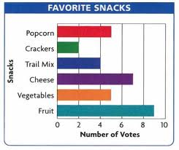
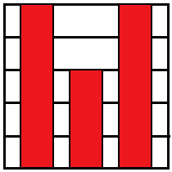
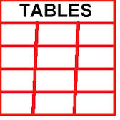
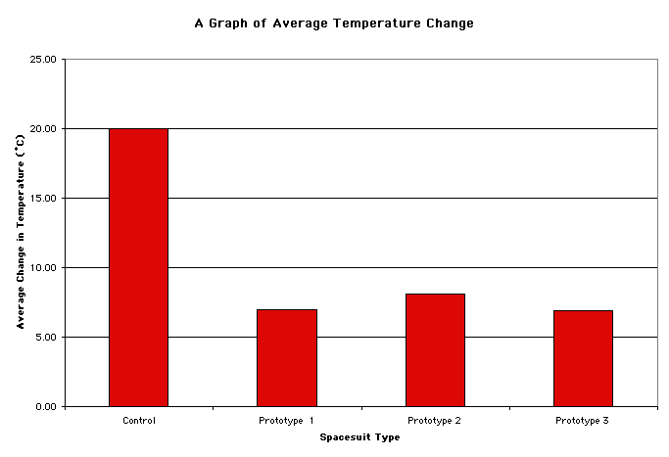
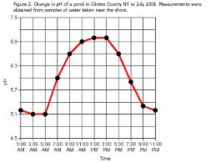
Final Thoughts
Of seven passages, six will simply ask you to analyze data in charts, tables, or graphs.
  Only one out of seven will be of the compare and contrast variety (usually).
  Repeated practice can enable anyone to succeed on the compare and contrast questions, especially when you start to spot the common aspects that are always a part of this kind of question.
vs.

Slide 61
Final Thoughts
To do well on the ACT Science exam, use the following strategies:
  1. Identify the subject matter of each passage.
  2. Determine why this research was conducted (what was the scientist trying to determine?).
  3. Determine what trends and correlations can be found in their data.
  4. Start with the easiest questions first (look-up questions, then spotting trends and drawing inferences) and save the hardest for last (scientific method, compare and contrast).
  5. Practice, practice, practice! The ACT Science exam tests your ability to think like a scientist (not your knowledge of science), and this ability can be improved through practice tests. The more you practice, the better you will do.

